Slide 1
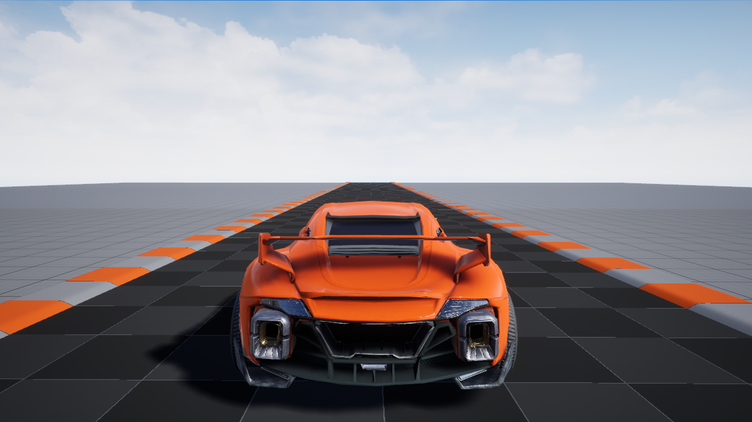




Dynamic VR Cabin (DVC)
Asad Melibaev, Lev Oleynik, Enoch Shen, Drew Hering
Notes:
Asad

Slide 2
System Overview
Goal: Create a Digital Twin/VR Environment that both reacts to real-world vehicle data and sends control commands for closed-loop interaction.
Key Components:
Visual Output: Meta Quest 3
Simulation Engine: Unreal Engine 5 (UE5)
Data Input: OBD Reader, Custom Steering Wheel Sensor, Camera Sensors
Networking: UDP Communication, Router LAN, and Tailscale (VPN)
Notes:
Asad

Slide 3
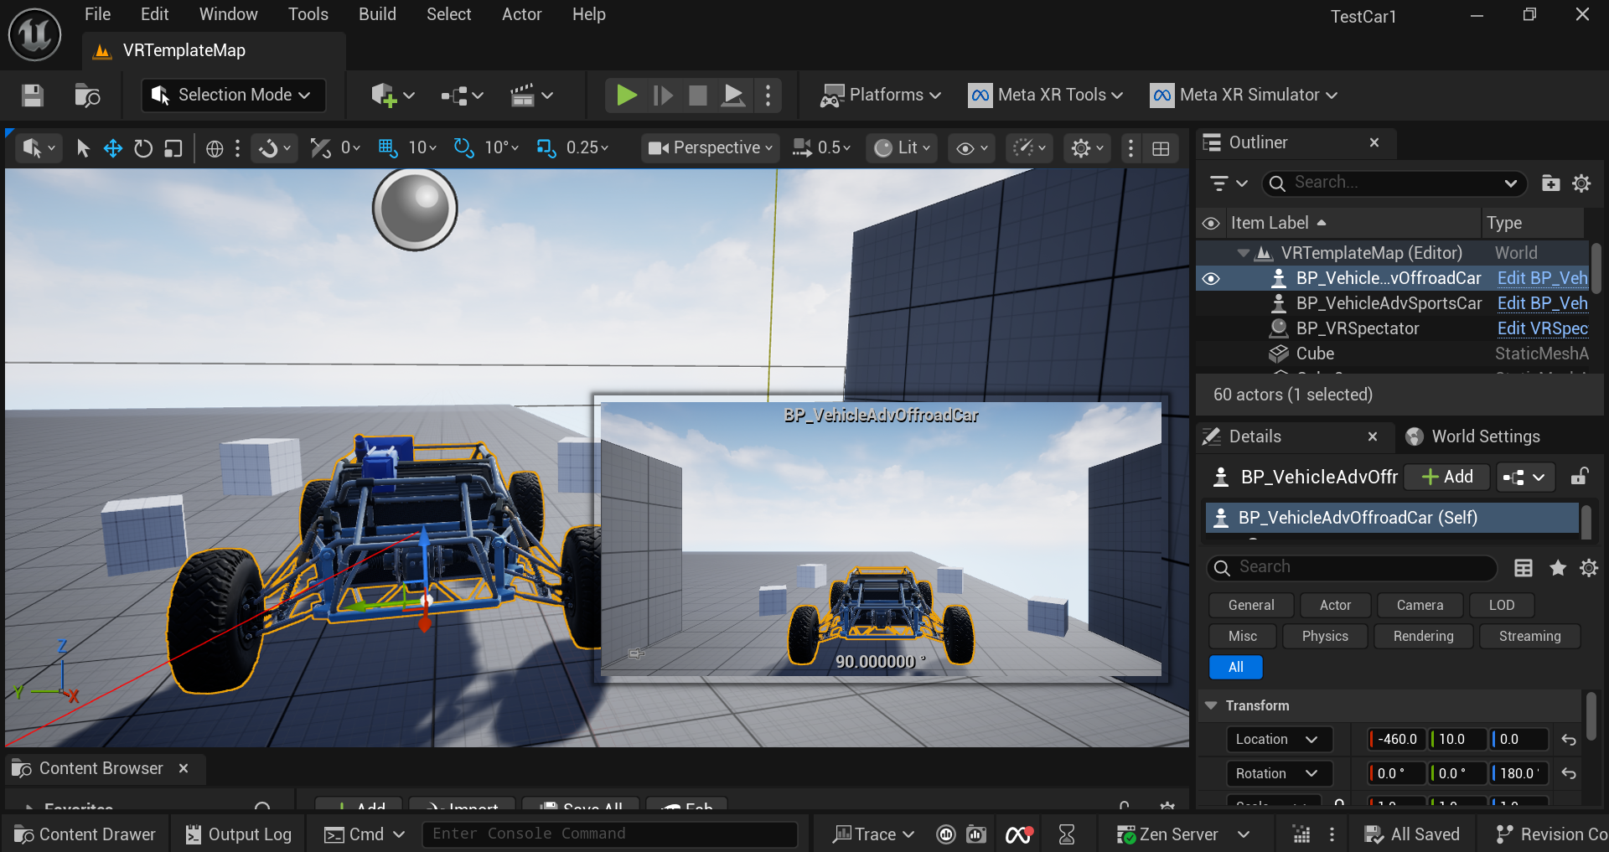
Subsystem 1 - VR Environment & Simulation
Enoch Shen & Lev Oleynik
Progress:
UE5 Environment: Successfully built a demo car interior and separated meshes
Meta Quest 3: Successfully packaged and built .apk files and uploaded demo worlds to the headset to run completely independently.
Notes:
Enoch

Slide 4
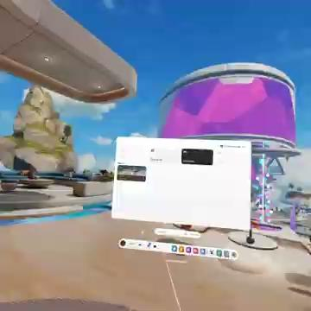
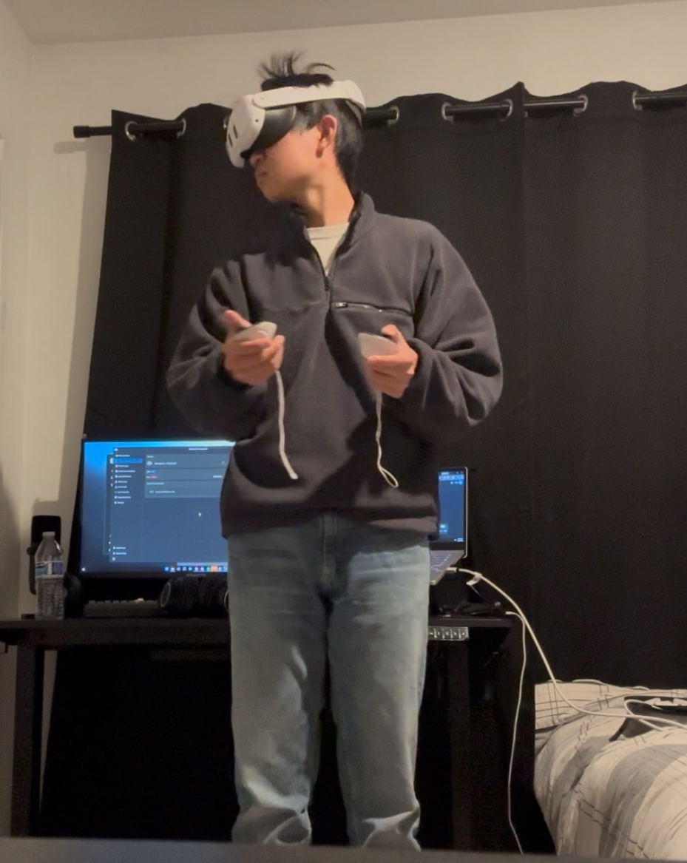
VR DEMO (controlled by joystick)
Notes:
Enoch

Slide 5
Subsystem 2 - Hardware & Sensors
Asad, Lev, Drew
Progress:
Designed custom steering wheel angle sensor
IMU drifts unpredictably; subtracting a stationary reference did not work as anticipated, so next step is integrating GPS data with a Kalman filter to reduce drift.
ELM327 OBD-II reader
Current Limitation: ELM327 can stream multiple PIDs (e.g., RPM and speed) but does so sequentially, causing slower update rates due to command–response overhead.
Potential Upgrade: Use a raw CAN interface to read multiple CAN frames in parallel.
Future Integration: Assessing Camera Sensors and ADAS integration for the next phase
Notes:
Lev

Slide 6
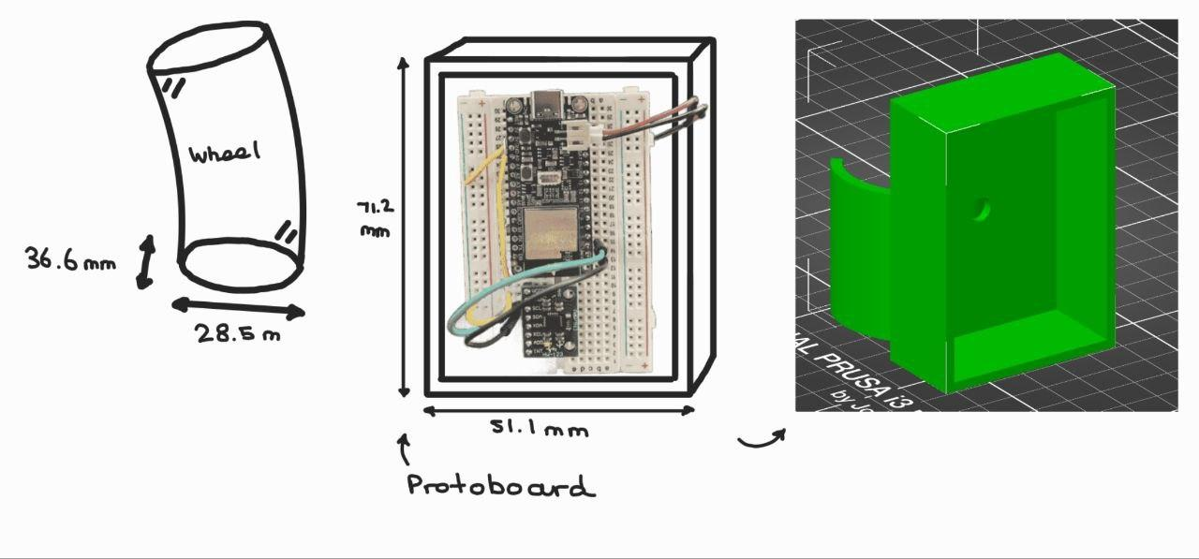
Steering Wheel Angle Sensor (for Digital Twin)
Notes:
Lev

Slide 7
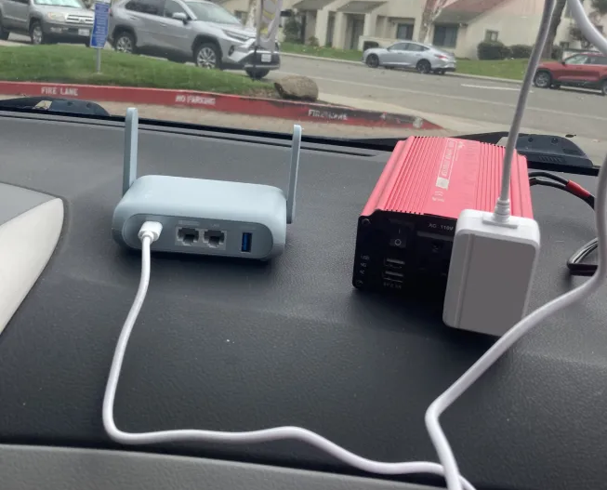
Subsystem 3 - Networking & Data Link
Asad, Enoch, Drew
C++ UDP plugin into UE5
Router creates LAN allowing all devices to communicate on the same subnet.
Optional: Router uses Tailscale (VPN) and phone hotspot (WAN connectivity) for remote control and monitoring.
C++ Serial (COM-port) plugin allowing data to be streamed via USB serial to UE5
Notes:
Drew

Slide 8
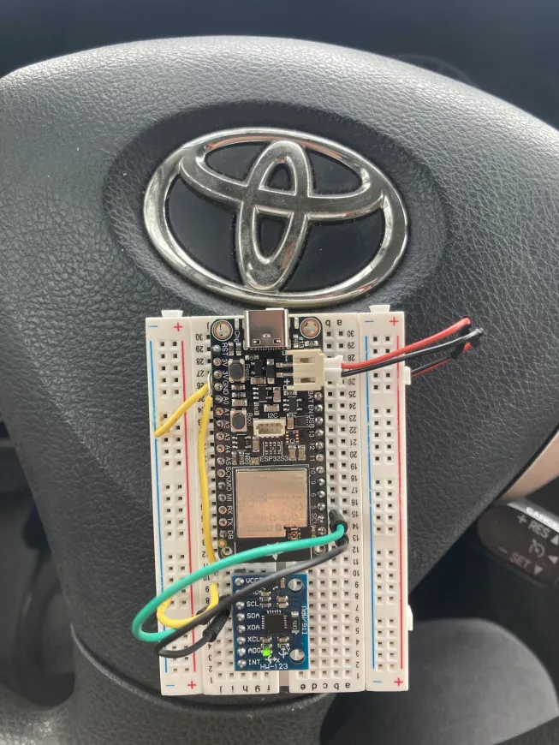
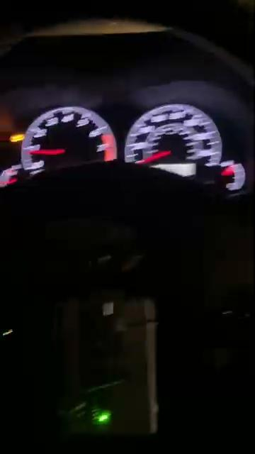
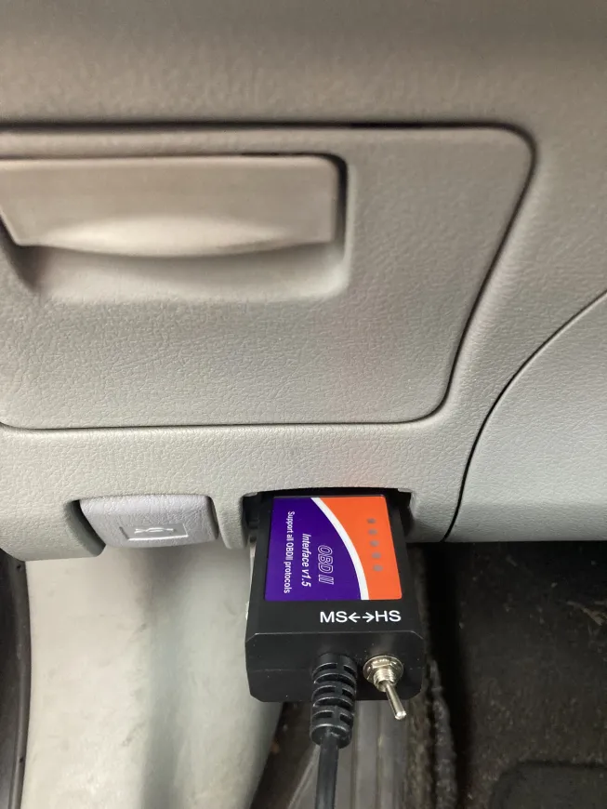
DEMO (digital twin)
steering wheel angle sensor (prototype)
Elm327 OBD-II
Notes:
Drew

Slide 9
The L2 ADAS
Asad
Developed proposal and parts list for BMW VP to purchase 2*160 FOV 4k cameras and Nvidia Jetson AGX/Nano and additional accessories.
The goal would be to obtain L2 autonomous driving capabilities as defined per by the SAE.
Additionally, incorporating the VR setup as a back up teleoperation solution.
A niche research goal could be to optimize bicycle detection and avoidance or develop the cheapest and most optimized L2 solution
We would also look into purchasing a car that we could operate through the steer-by-wire interface
Scheduled internal meeting with BMW EX Shanghai Autonomous Vehicles Manager to discuss research opportunities within this field
Notes:
Asad

Slide 10
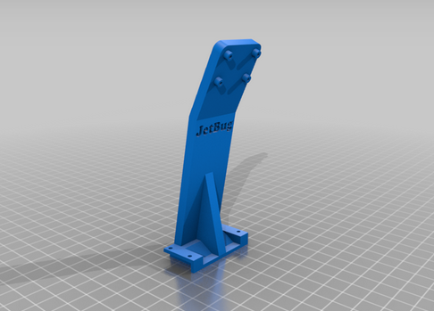
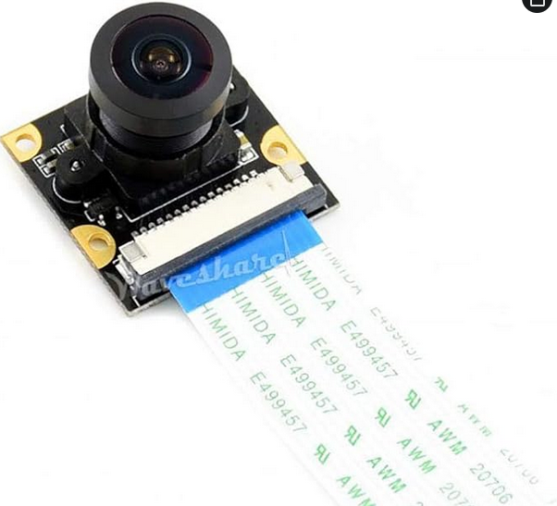
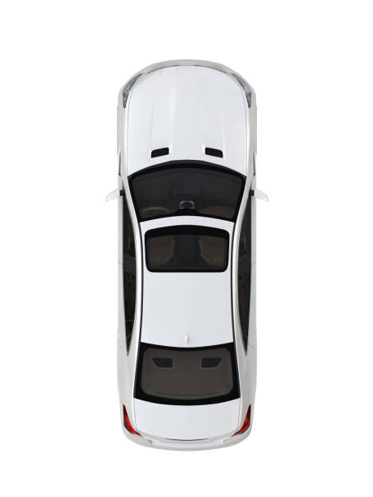
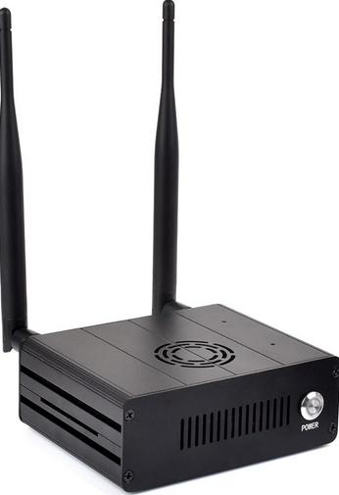
Mounts and brackets for Custom L2 setup
Ultrasonic 1
Ultrasonic 2
Cam 1
Cam 2
Potential redundant sensors could be LiDARs and radars
GPS + imu
Ultrasonic 3
Ultrasonic 4
Notes:
Asad

Slide 11
Current Prototype Status:
What works right now:
A “Digital Twin” in Unreal Engine (Steering, Speed)
We can compile this project, package it, and run it on the Quest 3
Monitoring and animation mapping
Goals:
Next step is adding active control (steering, throttle, lights, etc..) driven by L2 ADAS and remote user inputs as a backup system.
Utilize feedback from OBD-II to form closed-loop control (e.g., PID-based corrections between commanded and actual states).

Slide 12
Conclusion
Summary: We have successfully built the software foundation and are ready to finalize and integrate the physical sensors in Winter Quarter.
Questions?
Notes:
Drew

Slide 13
Quarter 2 Rough Roadmap (Weeks 1 - 10)
Winter Break: Finalize the “Digital Twin” Implementation
Weeks 1 - 4:
Hardware Focus - Final integration of the Steering Wheel Sensor and Camera Sensors
Weeks 5 - 7:
Software Focus - Incorporate ADAS system data streams into the simulation
Weeks 8- 10:
Final Presentation: Polish and Live Drive Demo

Slide 14
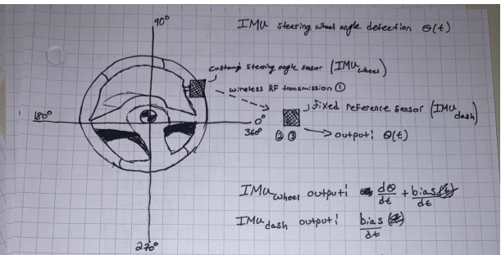
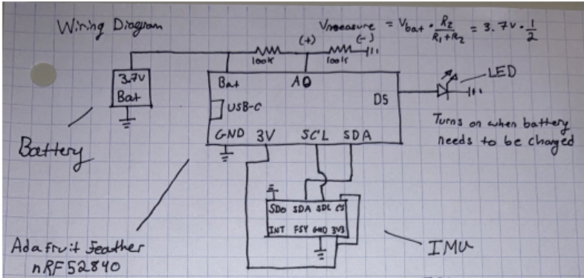
Hardware:
Adafruit S3 Esp32
IMU: GY-521
3.7 V Lipo battery

